Slide 1
Welcome to Azure DevOps
YBS –Retail Lending

Slide 2
Introduction
Thank you so much for joining this session. I will try to make this session very interactive and hopefully you will enjoy it and get to know high level understanding how DevOps system works.
It’s only 1 hour session, so its very less time to go through all aspect, So few things I will cover very quick because we all know it very well, like DevOps Board – We all are using JIRA since long for project management, so I think we all knows much about this system. However Azure DevOps have much better features then JIRA, but we will look into it later on.

Slide 3
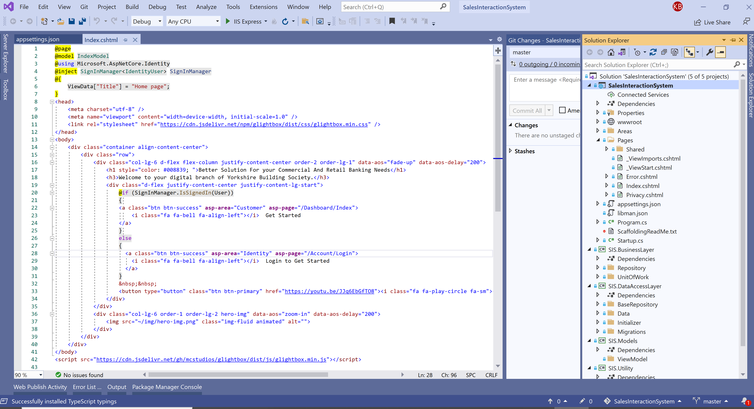
DevOps Infrastructure and Environment
How it configured in our On-premise machine:
1
Developed a .Net Core Razor Page Application – Developed a Web Application using .Net Core RazorPage for this demo, and to represent how azure devops works for CI/CD.
2
Local Source Control– Configured Git as local source control system
3
Centralized Source Control - Configured Azure Repository on H30007 as centralized source control system.
4
Azure DevOps Sever setup configured on H30007 and can be accessed by using - http://h30007:85/DefaultCollection
Entire Features – Including Board, Repository build pipeline, Test plans and Artifacts can be managed by using this ULR path.

Slide 4
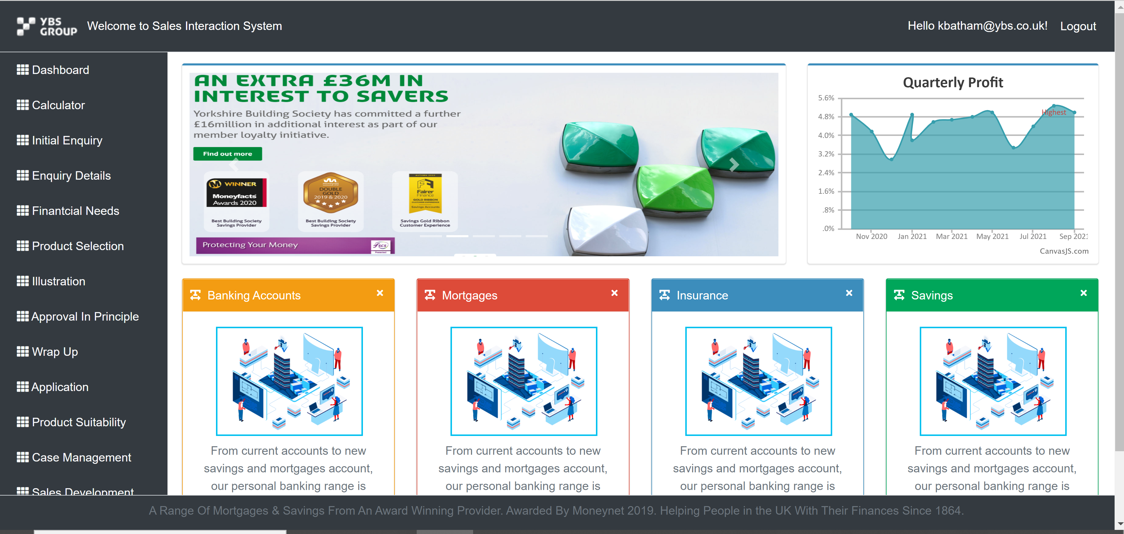
DevOps Infrastructure and Environment
How it configured in our On-premise machine:
1
Used H30007 (Windows 10) machine – Configured the Environment of Azure DevOps Server on H30007.
2
For Testing Purpose – Set the H30007 as QA environment and configured the Web Server (IIS) to deploy application using DevOps Pipeline. - http://h30007.ybs.com/
3
Set up H30022 – Configured H30022 As the production environment. DevOps Pipeline automated the deployment to Prod environment. We can browse deployed application using below URL - http://h30022:80/

Slide 5
Release & Deployment Issue
Ok, So first lets talk about the release and deployment issue for small changes or the release process.
So, We all are in IT industry since long, and what we have noticed that the development work usually go very smooth, but more pain comes when we plan to release the changes ->
Sometimes when we have very small change but when plan for release it looks like a mammoth. and the reasons are
Collaborate with Database and Networking and Operation team, get their time and decide the plan and release date. And It’s not very straightforward process for the small changes.
Usually we have to plan our release along with other teams release even thought it was very small change.
Another reason is – when we go for Agile release, where we look for faster integration cycles, doing all these activities within 2 weeks of Spring cycle is not possible. Because we want to release changes very soon, but it doesn’t work.
Sometimes we encounter regression- and mostly the reasons for this is -> our deployment environment ( I mean UAT, QA, and Production) is configured entirely differently then our Dev environment. -> And what happen something somewhere, we missed during release which further causes release regression.
We can overcome with all above concern using DevOps.

Slide 6
Waterfall & Agile
So, for better understanding DevOps, let’s quickly start with old traditional process.
Traditional Waterfall Model – So as we knows that, This was something that involves step by step process of requirement analysis, design, coding, testing, deployment and maintenance. But there were lot of bottlenecks in this traditional method, and it was the time consuming as well.
And when there was an issue with any phase, we cannot switch to the previous step. Therefore This model was suited to a product whose business requirement was very clear.
That's why we adopted the agile methodology.
Now in Agile Methodology: Agile is a software development methodology that employs 4 different values and 12 principles ( I am not going into it at this moment because it will take much time), so these Values and Principles helps in building the Agile software Development culture. It emphasizes on incremental, iterative and evolutionary development.
But when we talk about release, we still are on the same place where we was during Traditional Waterfall Model.
It means that in Agile methodology - Only development phase has agility feature.

Slide 7
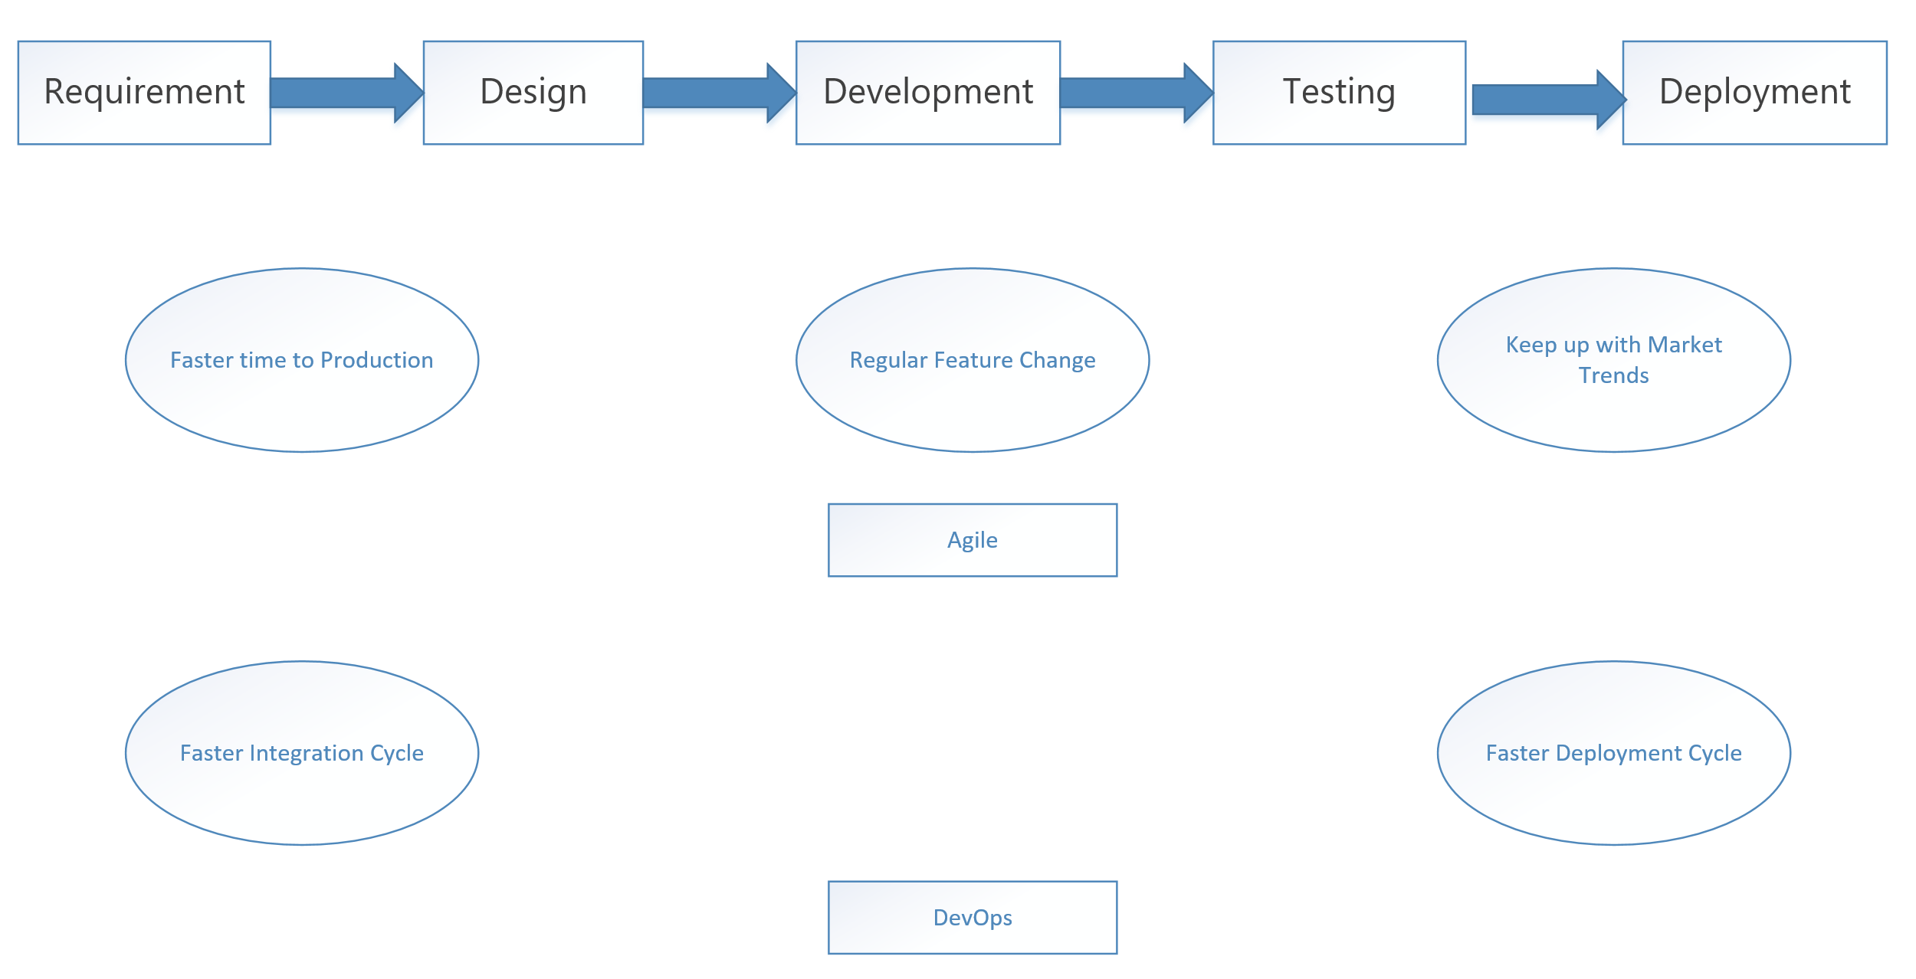
Agile way of work
Now when we go through the SDLC process – it is
Requirement -> Design -> Development -> Testing -> Deployment.
But doing it at once shot-> getting all the requirements, all the design, all relevant at one time, doesn't work like that.
In Real Scenario -> Business gives regular feature changes to the IT department.
Dev team also comes up with few technical constraint which comes up further change.
During the design phase we have many changes when it comes to their application changes.
So we adopt the agile methodology.
So when it comes to agile, we are also looking to ensure that we have faster integration cycles. So when a developer makes a change onto a code. It should be integrated very easily and can be tested and deploy soon into production.
So what we want to do the use of agile as the underlying methodology for the application lifecycle, along with faster integration and Deployment -> and that's where we come to the term of DevOps.

Slide 8
DevOps
DevOps—is the amalgamation of development (Dev) and operations (Ops) teams—is an organizational approach that enables faster development of applications and easier maintenance of existing deployments.
So here we are on the same stage of ‘Agile way of work’ along with the adoption of DevOps model to overcome with our release and deployment concern.
So, As we know in Agile methodology - Only development phase has agility feature.
Where as in DevOps - Both Development and Operation have agility feature.
Therefore DevOps increase the speed, efficiency and quality of software delivery. Along with Improving Employee Engagement, offers Faster Software Development and Deployment Cycle, Cost Saving system and Good for Business growth

Slide 9
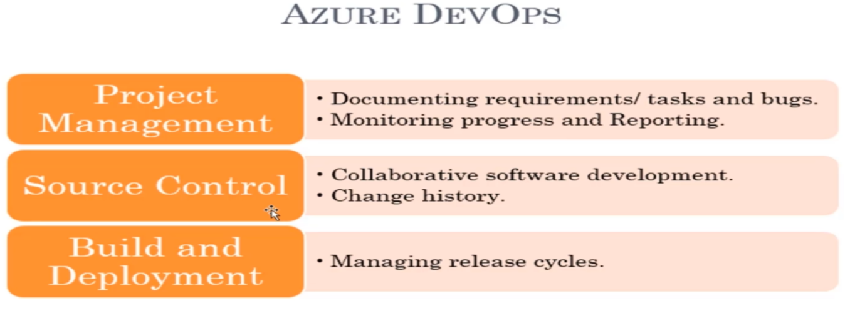
Azure DevOps Offerings
For any software project, we need three things.
Every software project needs a project management to a place where we can gather the requirements, break it up into various tasks and assign people and monitor those tasks.
Every software project needs a source control or version control tool. The source control tool will maintain who made what changes and maintain the history of the code changes.
Every software project needs a built in deployment tool. A build server that generates exe, msi or binaries, that we deployed into UAT and Production.
Azure DevOps can do all these three.

Slide 10
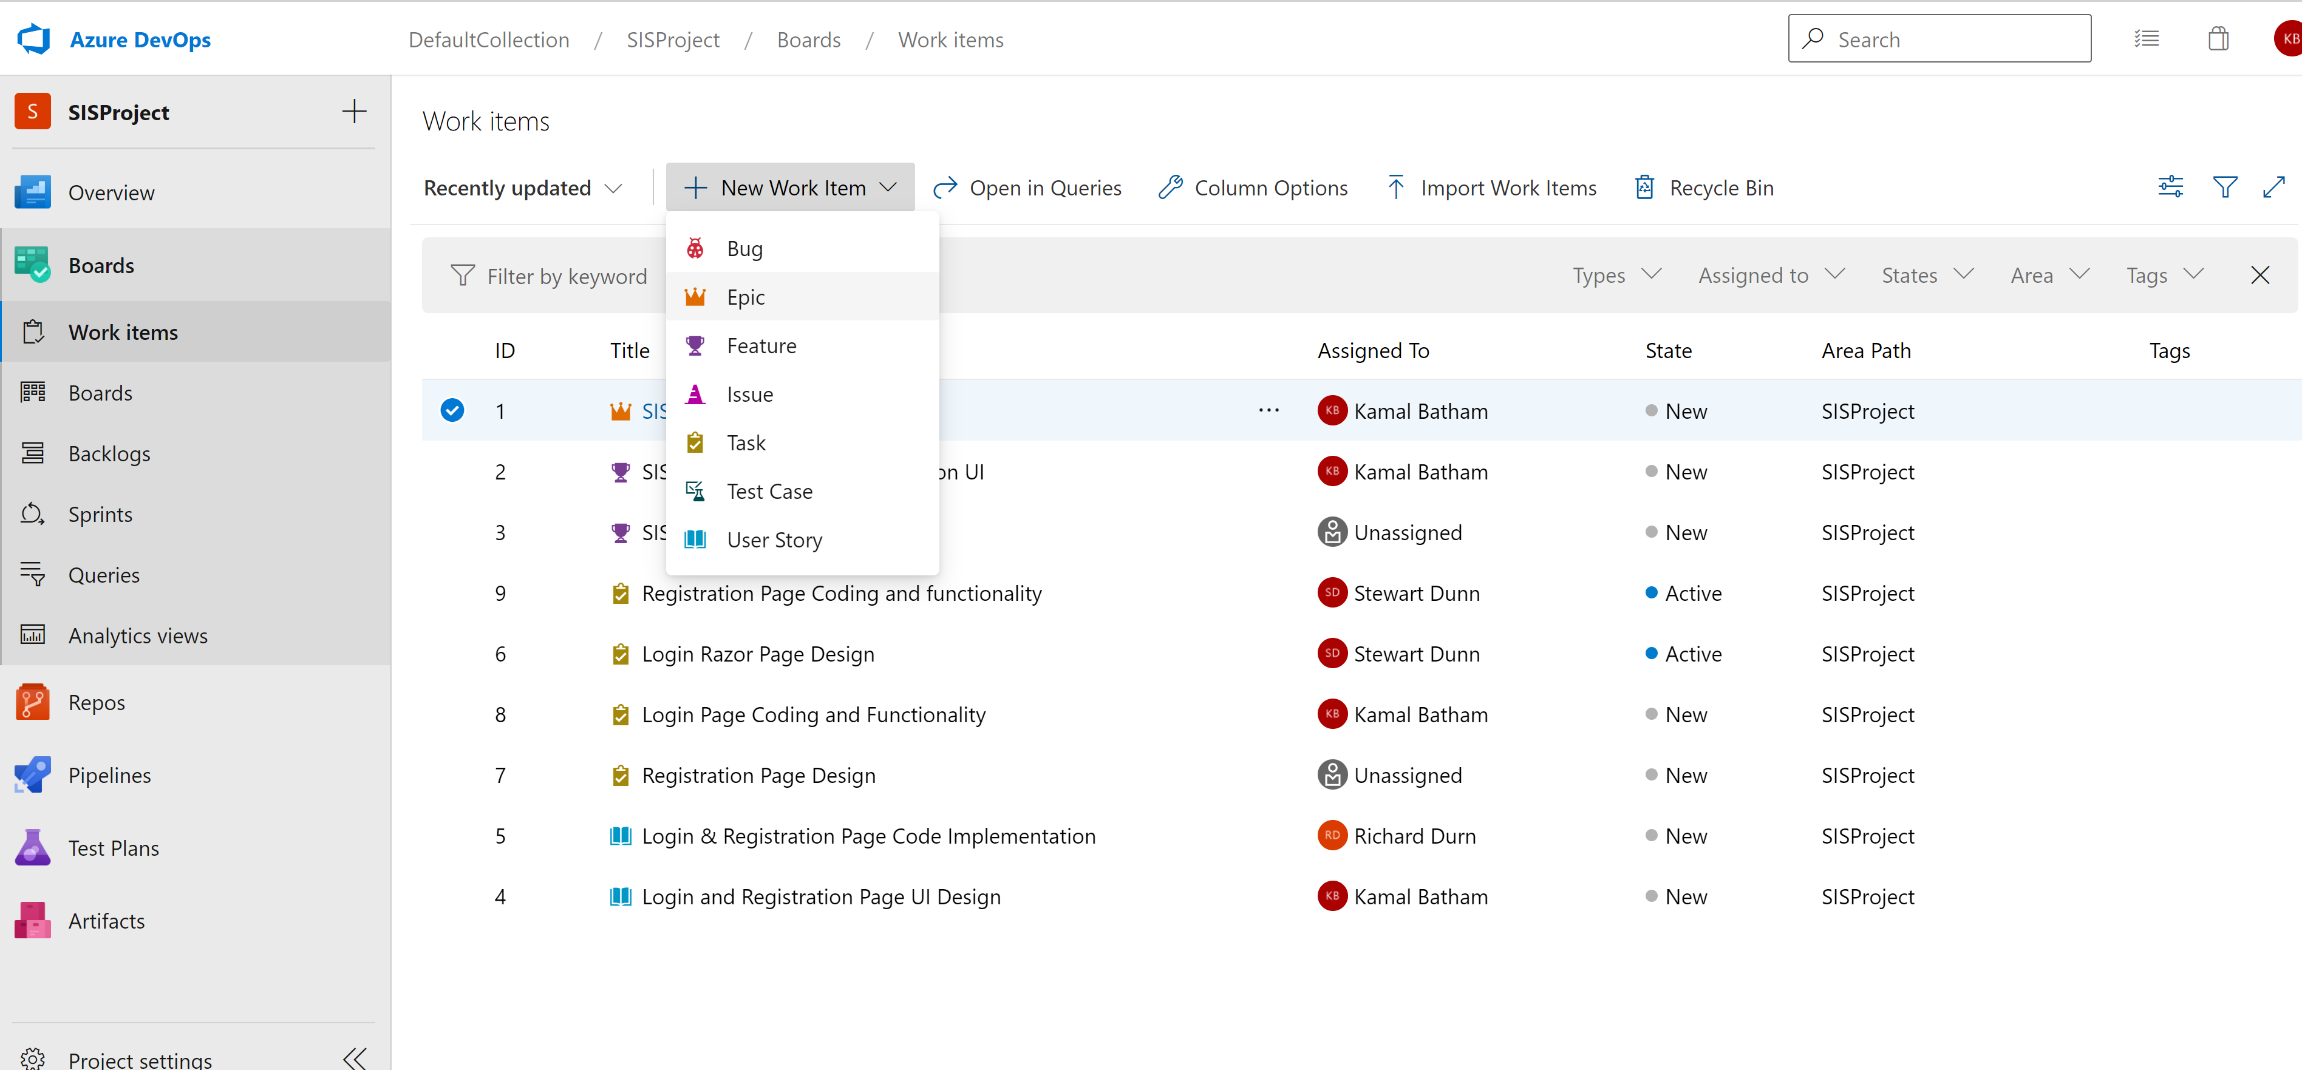
Azure DevOps Board
Board provides project management place where we can gather the requirements, break it up into various tasks add Epic, feature, User Stories, Tasks, Bugs and other.
Offers Project Planning: Using Agile, SCRUM, CMMI, & Basic Lifecycle.
We can integrate Azure Board with Microsoft team - We can go ahead and use the Azure board's application for Microsoft teams to go out and create work items and even monitor the item activities from within the team's channel.
So we can receive and manage notification for work item events in the MS team's channel.
Single Platform to do everything for which we use ALM for defect, JIRA for project management, and Service Connect for Incidents.

Slide 11
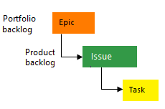
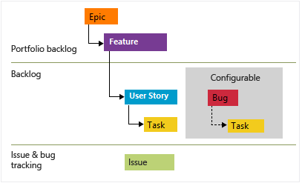
Process offered by DevOps
Basic : Choose Basic when team wants the simplest model that uses Issues, Tasks, and Epics to track work.
Agile: Choose Agile when team uses Agile planning methods, including Scrum, and tracks development and test activities separately. This process works great if you want to track user stories and (optionally) bugs on the Kanban board, or track bugs and tasks on the taskboard.

Slide 12
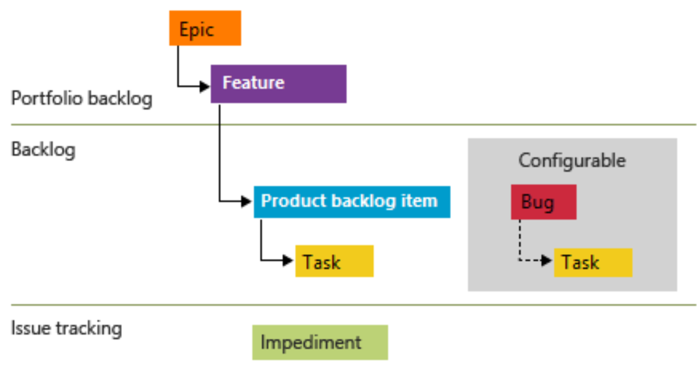
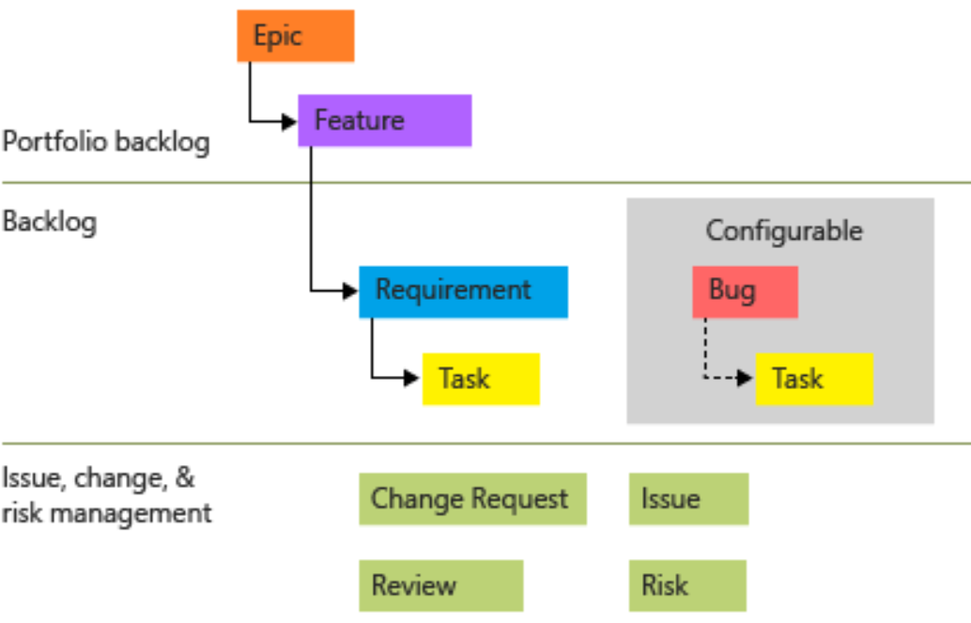
Process offered by DevOps
Scrum: Choose Scrum when your team practices Scrum. This process works great if you want to track product backlog items and bugs on the Kanban board, or break PBIs and bugs down into tasks on the taskboard.
CMMI: Choose CMMI when your team follows more formal project methods that require a framework for process improvement and an auditable record of decisions. With this process, you can track requirements, change requests, risks, and reviews.

Slide 13
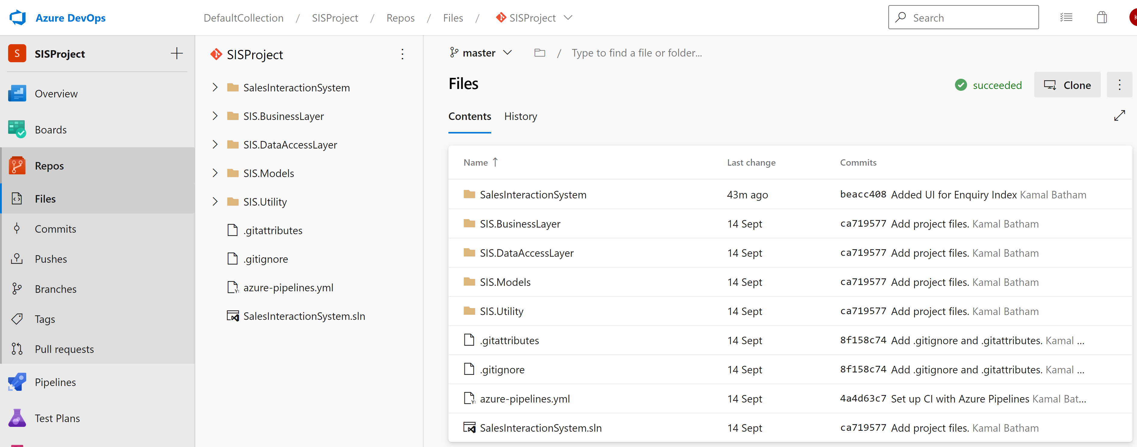
Azure DevOps Git Repository
In this setup entire system configured on our on-premise machine (H30007), so when we push the code from local machine (local GIT) to Azure Repo, it creates master branch on H30007. Benefits ->
Collaboration - teams can work concurrently, even on the same sections of code, which are merged together.
Workflows - teams check the quality of each others code, ensuring compliance with coding standards..
Versioning - source code can be tagged so that released versions of code can be referred back to.
History - a full history of the code repository is maintained and linked to a users credentials. If changes are well commented, this can assist in issue resolution.
Automation - actions within a version control system, such as checking in a code change, can be set to trigger other operatons, such as compilation and testing.

Slide 14
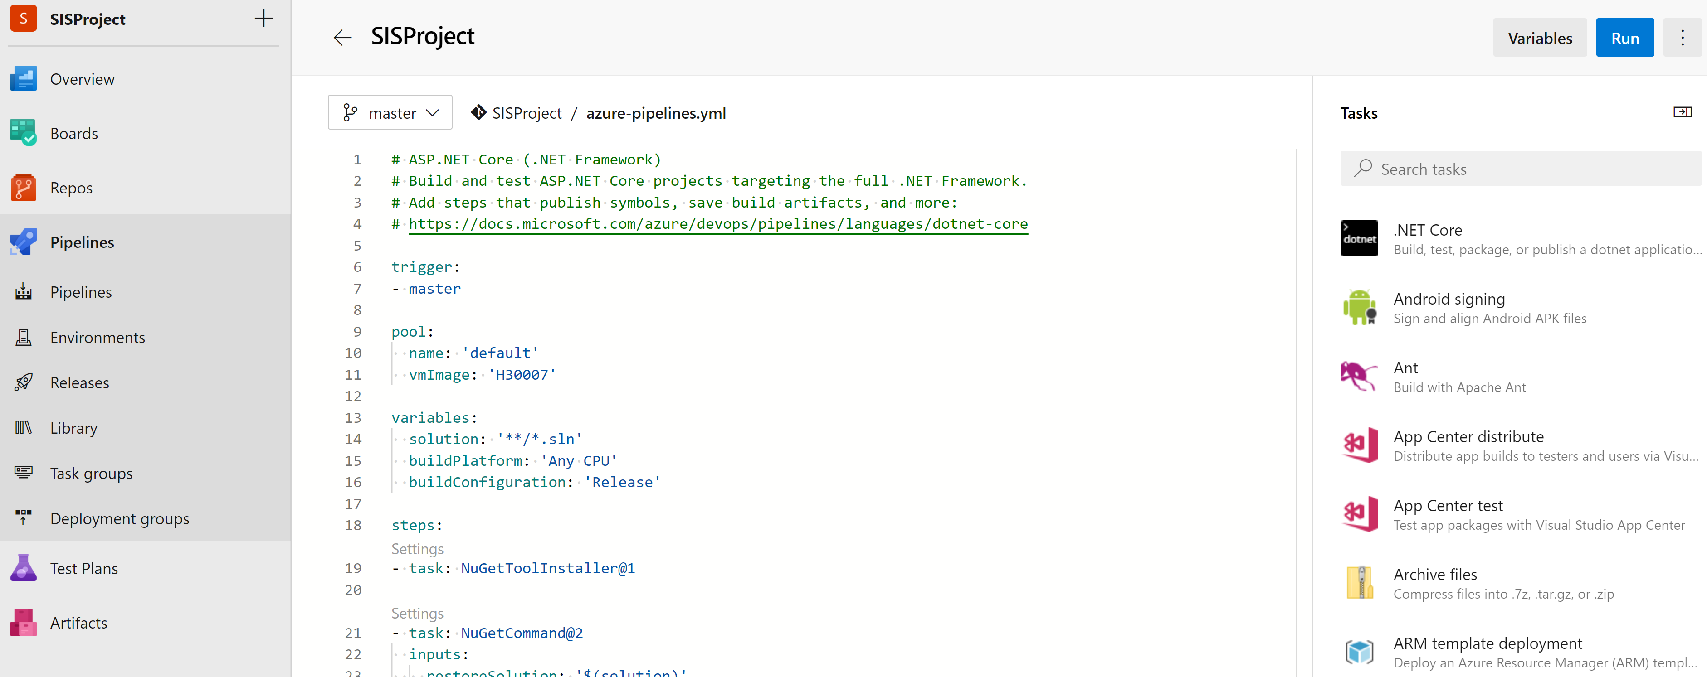
Build Pipeline
Build, or Build Pipeline represents CI (continuous integration) in Azure DevOps. We usually used the Build Pipeline to build/create software binaries
Build Pipeline used to build a specific version of application and then use the publishes binaries in each of your target environment (e. g. dev / test / production).
Once Build done successfully, it generates the binaries in Artifact, stored it to server for further deployment.
Once Artifact created – Release pipeline pull the Artifact and deployed it into configured environment (e. g. dev / test / production).
In Build pipeline we configured a trigger, which reads the Git Repository and when new code checked-in, it automatically triggered the Build process.

Slide 15
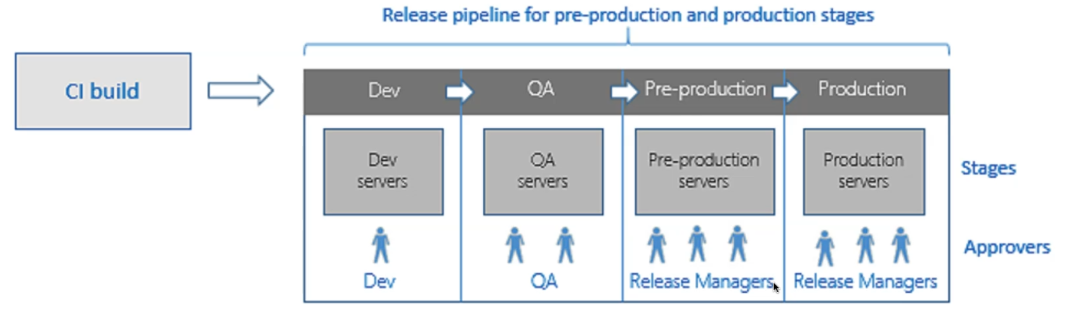
Azure DevOps Release Pipeline
When Developer check-in the code and push the code into centralised source control (Here we have Azure Git Repository) -> Build Server build the source code and generate the publish artifacts
As soon as Release Pipeline got the new Artifacts (we can say new Image or new release) -> It trigger the release process towards first stage of deployment (Dev Server or QA server whatever we have configured) Test team will go ahead and test the entire changes.
Once Testing done, Test Manager go ahead and approve it. Release pipeline trigger the process again and publish the changes into Pre-prod (Staging environment)

Slide 16
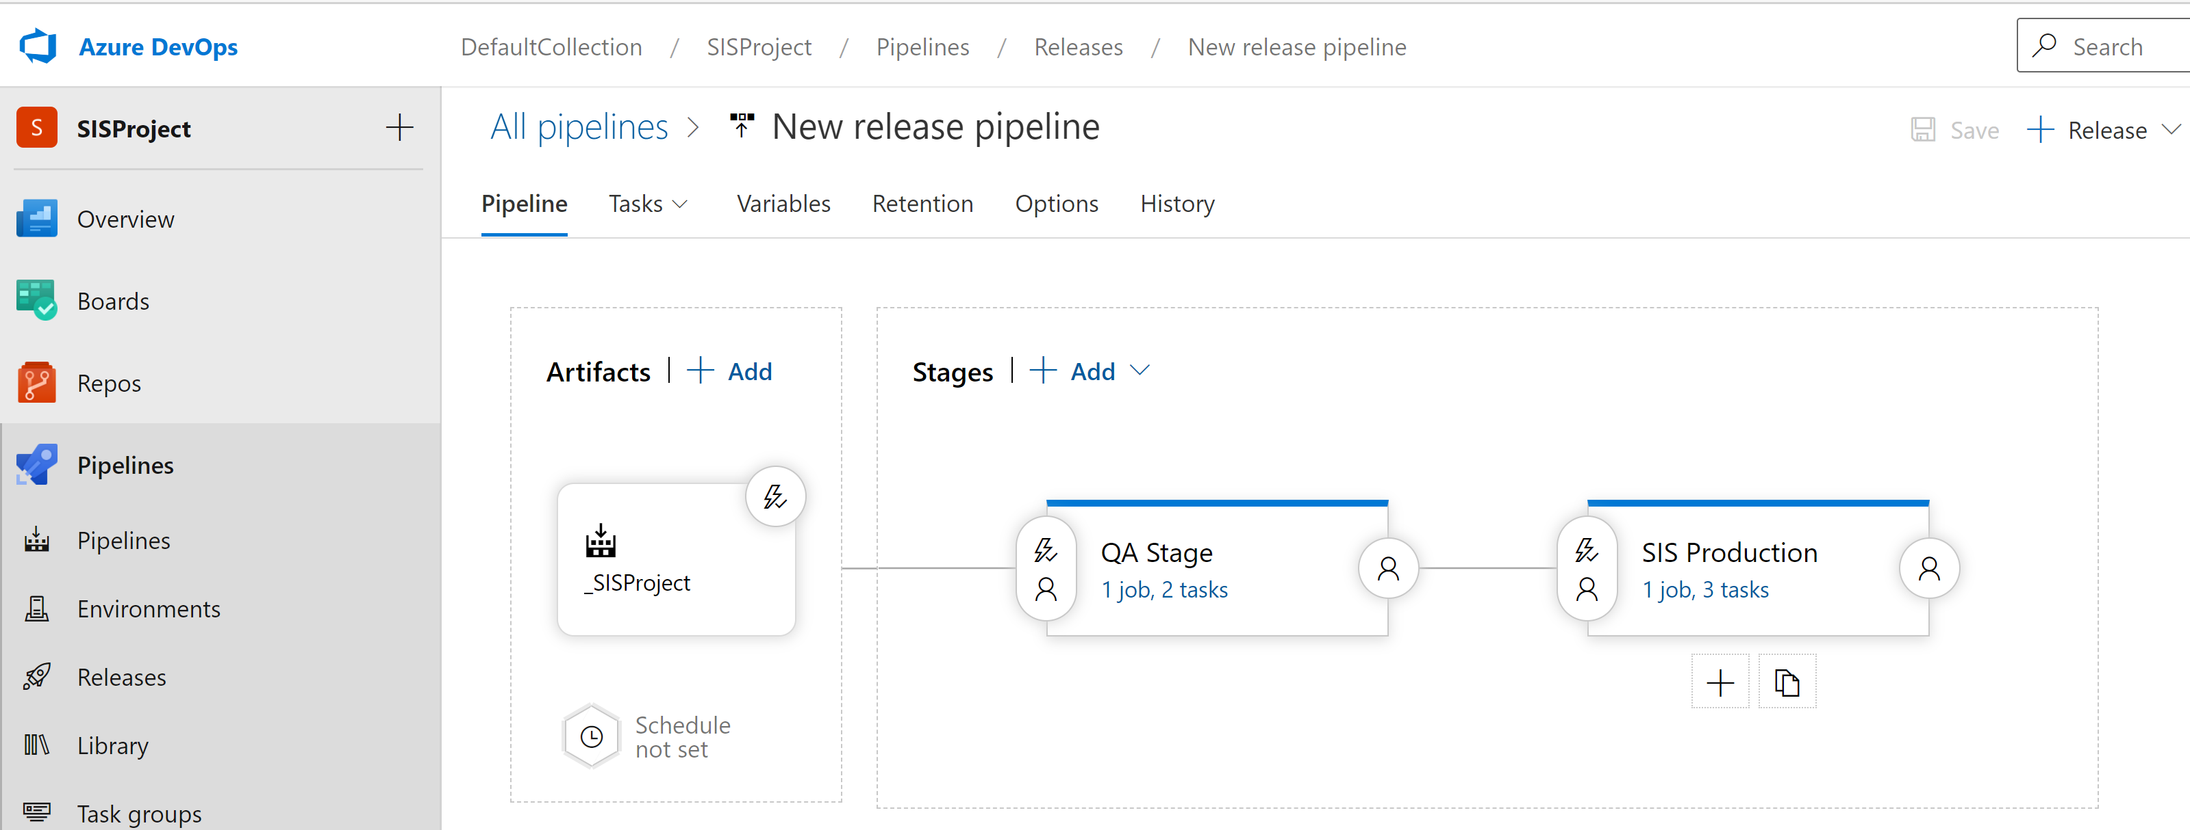
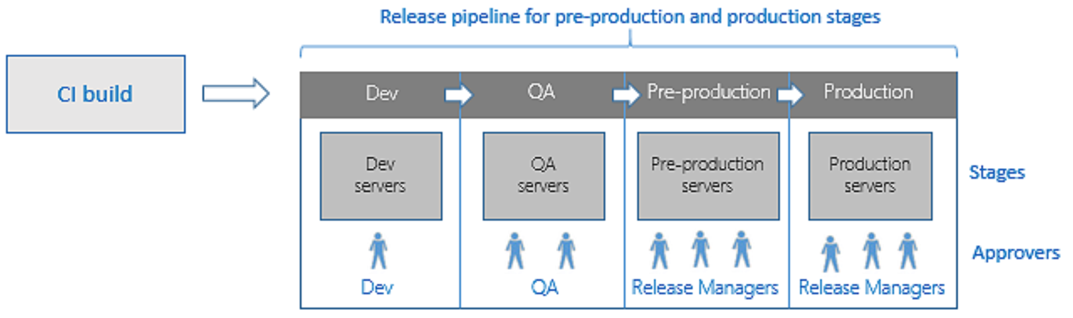
Release Pipeline
Release represents CD (continuous delivery) in Azure DevOps. Build Pipeline usually takes code, builds it, tests and creates an artifact. Release Pipeline takes the Artifact and releases/deploys it into UAT or Production environment.
Release pipelines help team continuously deliver software to your customers at a faster pace and with lower risk. You can fully automate the testing and delivery of your software in multiple stages all the way to production. Or, set up semi-automated processes with approvals and on-demand deployments.

Slide 17
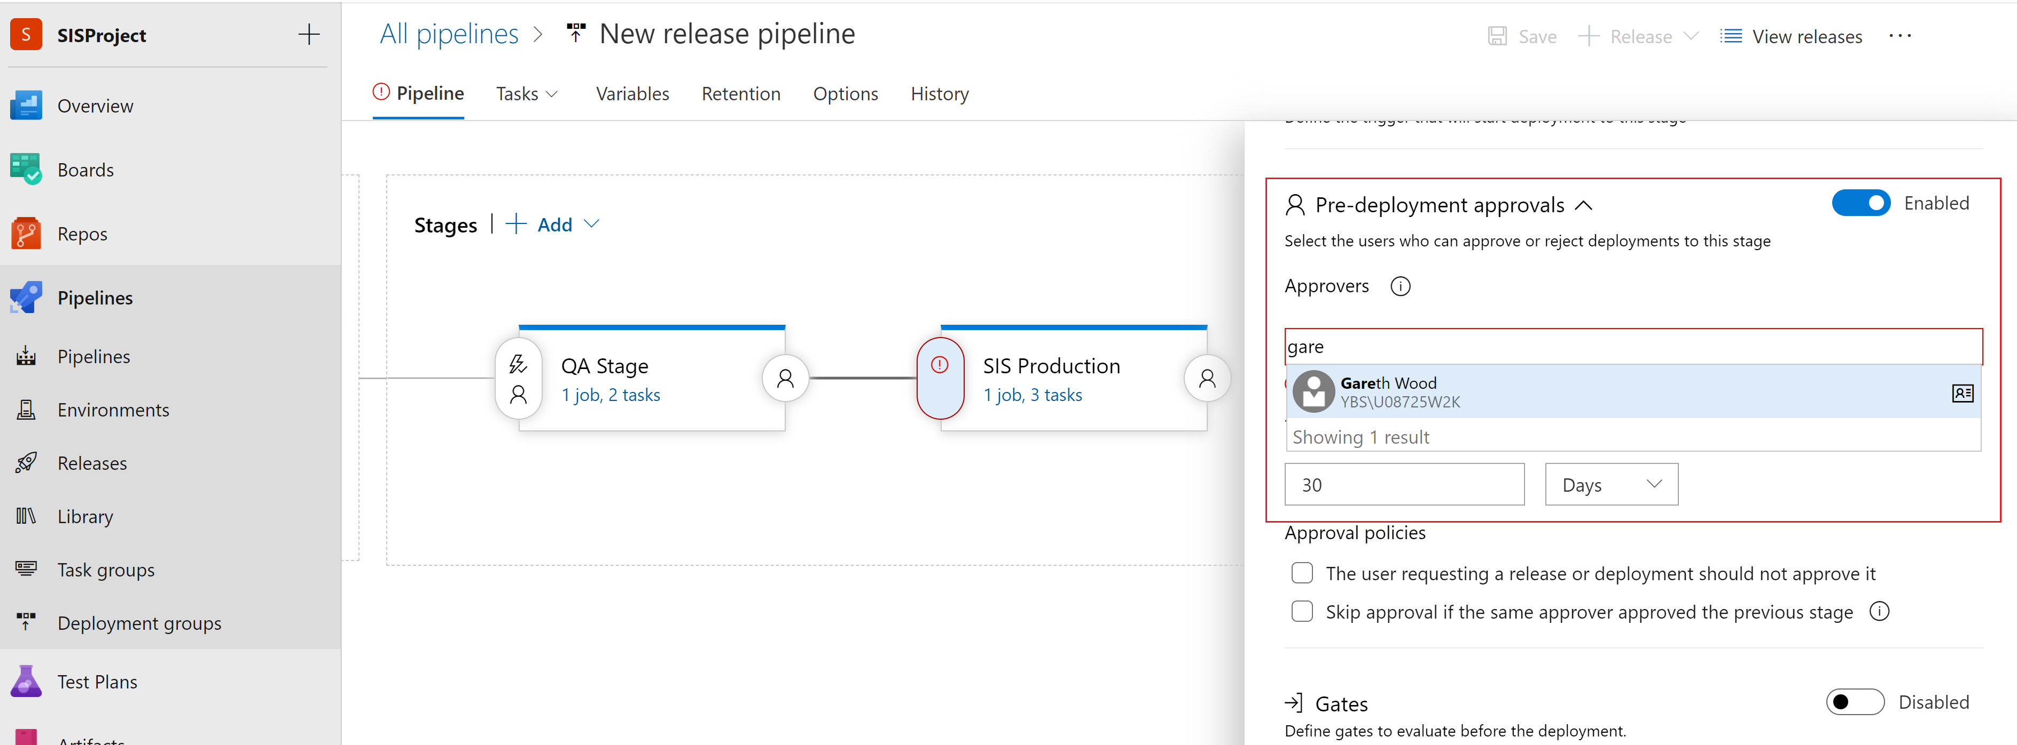
Gates and Approval
At the each stage of release pipeline -> we have Pre and Post deployment condition where we can configured the approvals, Gates to only allow release pipeline to publish the code when meet the conditions.
For example; For Approvals – we can enable the pre-deployment approvals -> Assign the approval Authority -> Now deployment from QA stage to Production stage only be possible once approved by….

Slide 18
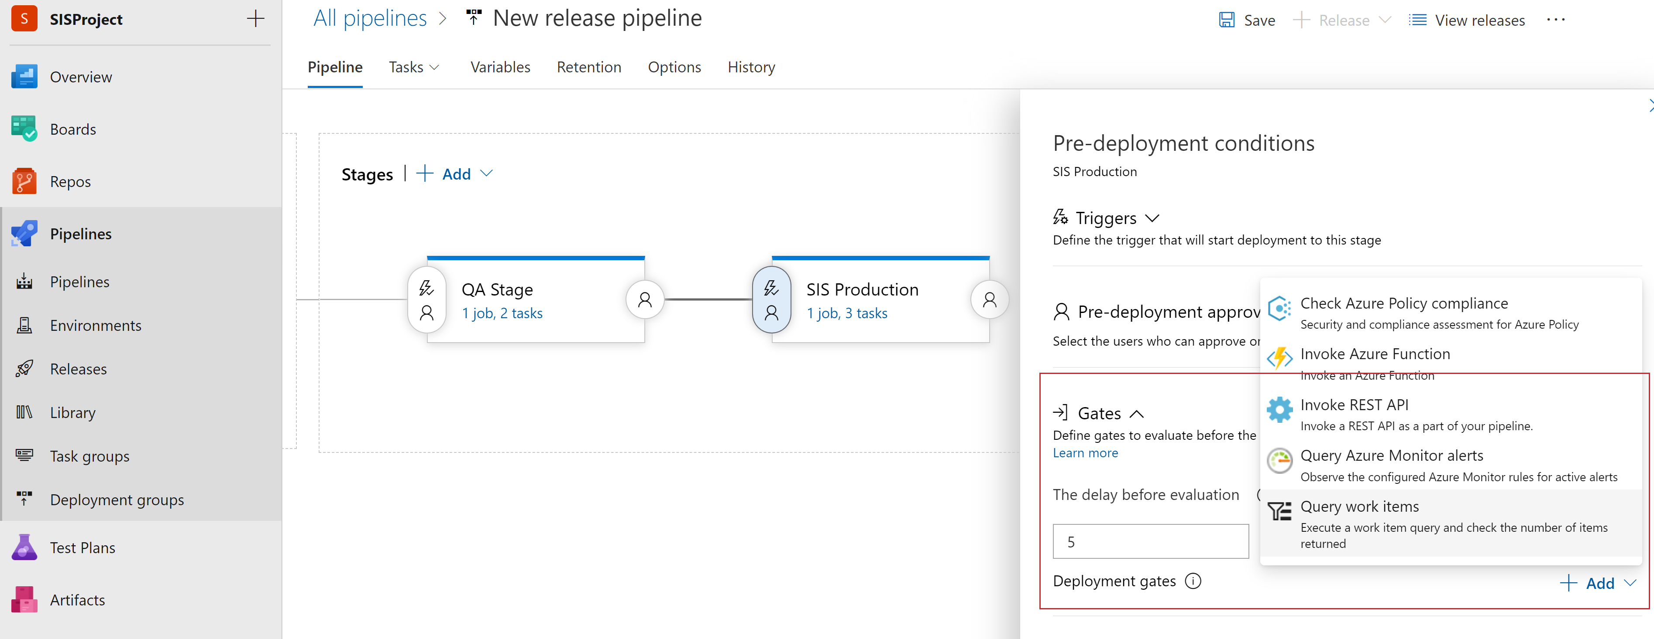
Gates
At the each stage of release pipeline -> we have Pre and Post deployment condition where we can configured the approvals, Gates to only allow release pipeline to publish the code when meet the conditions.
For example; For Approvals – we can enable the pre-deployment approvals -> Assign the approval Authority -> Now deployment from QA stage to Production stage only be possible once approved by….

Slide 19
Agile Values
Values1. Individuals and Interactions Over Processes and Tools
2. Working Software Over Comprehensive Documentation
3. Customer Collaboration Over Contract Negotiation
4. Responding to Change Over Following a Plan

Slide 20
Agile Principles
Principles:
Customer satisfaction through early and continuous software delivery
Accommodate changing requirements throughout the development process
Frequent delivery of working software
Support, trust, and motivate the people involved
Enable face-to-face interactions
Working software is the primary measure of progress
Agile processes to support a consistent development pace
Attention to technical detail and design enhances agility
Simplicity
Self-organizing teams encourage great architectures, requirements, and designs
Regular reflections on how to become more effective

Slide 21
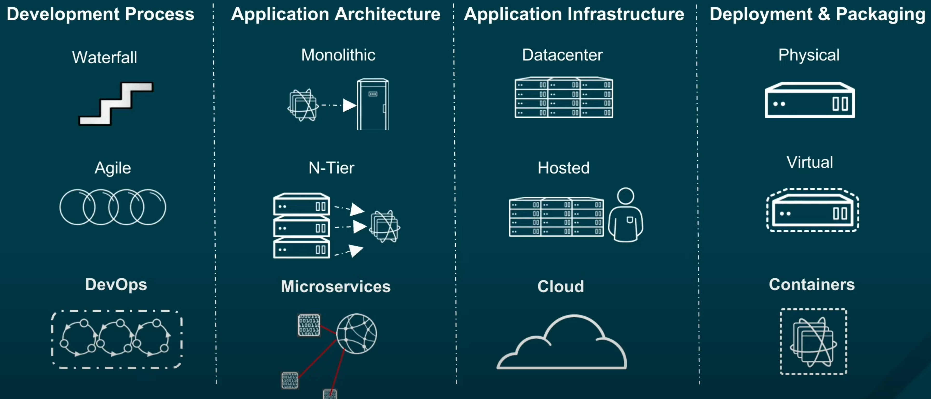
IT Transformation

Slide 22
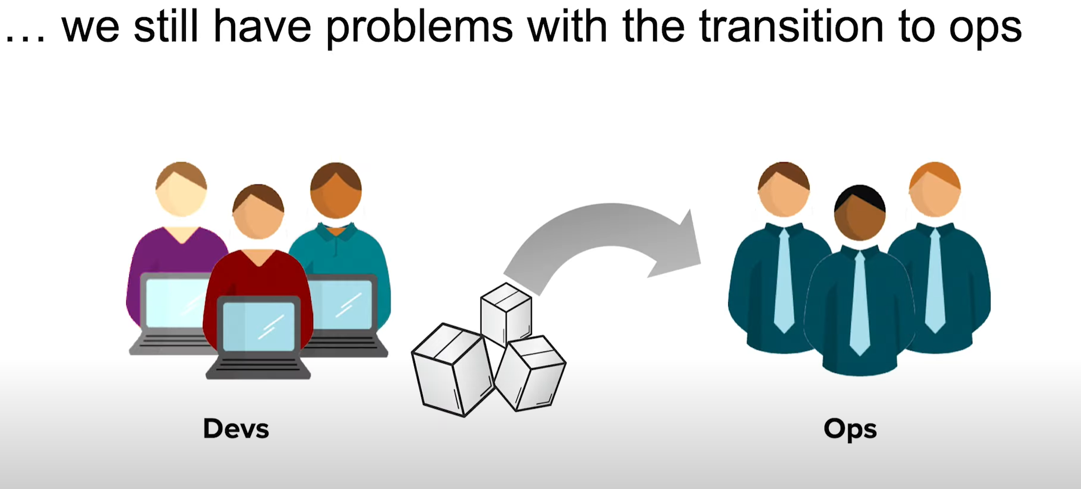
Issues Operation Team have when they go for Deployment
DevOps Solve this problem for Us.

Slide 23
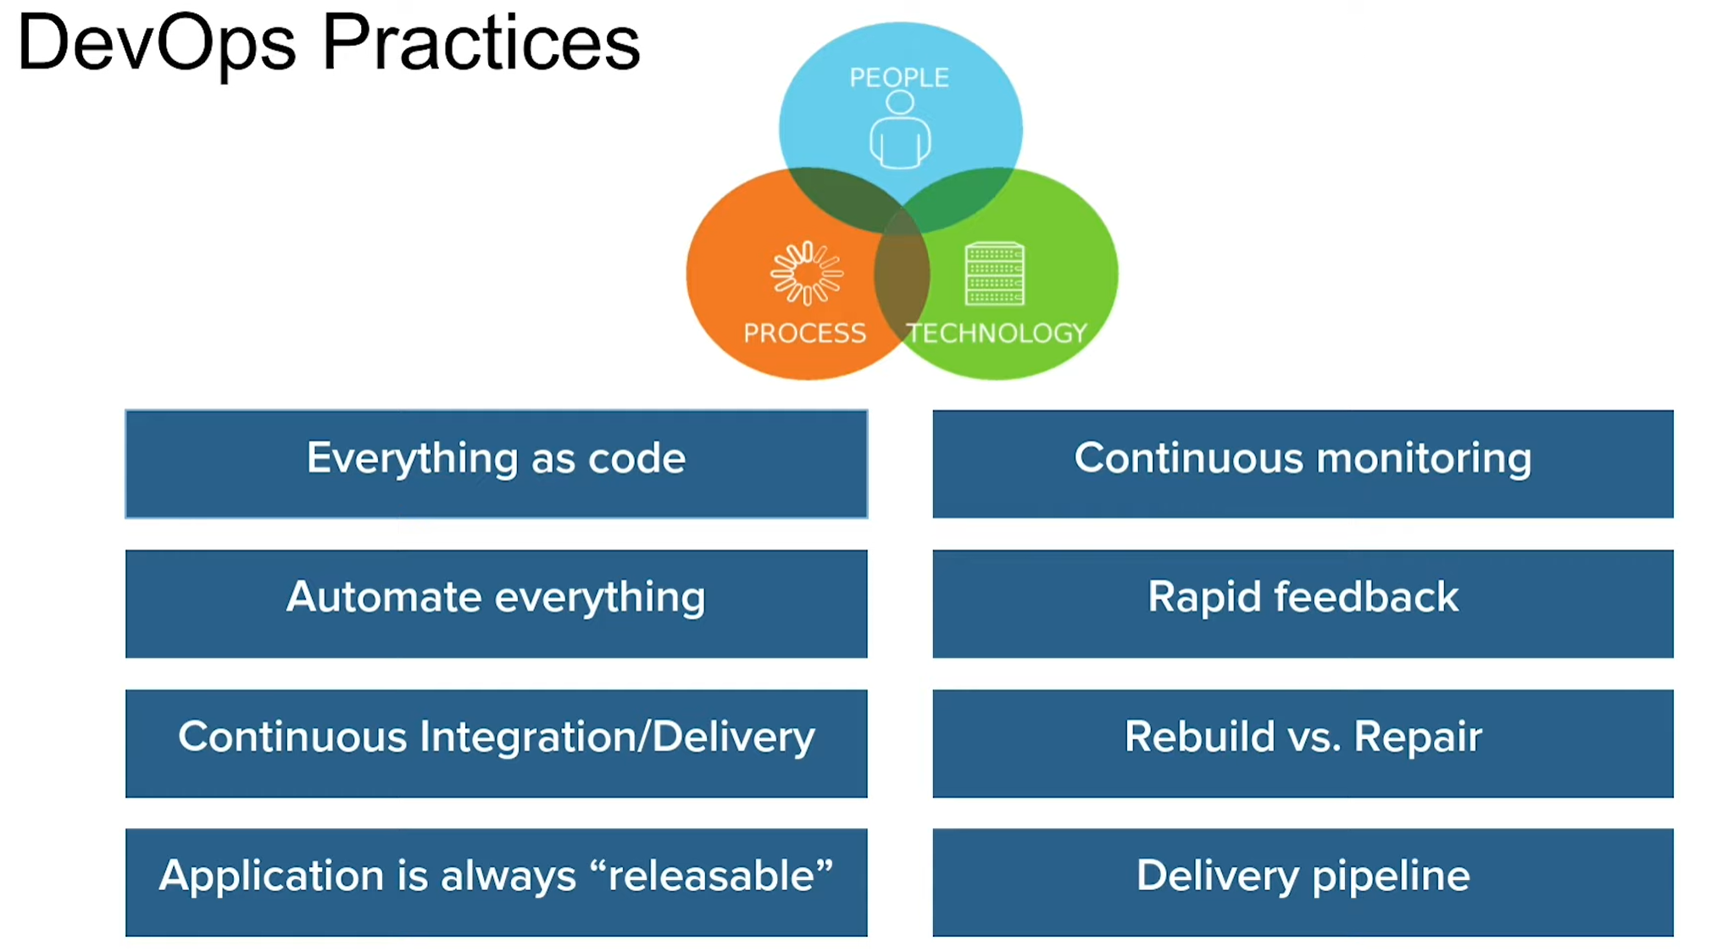
Solution using DevOps

Slide 24
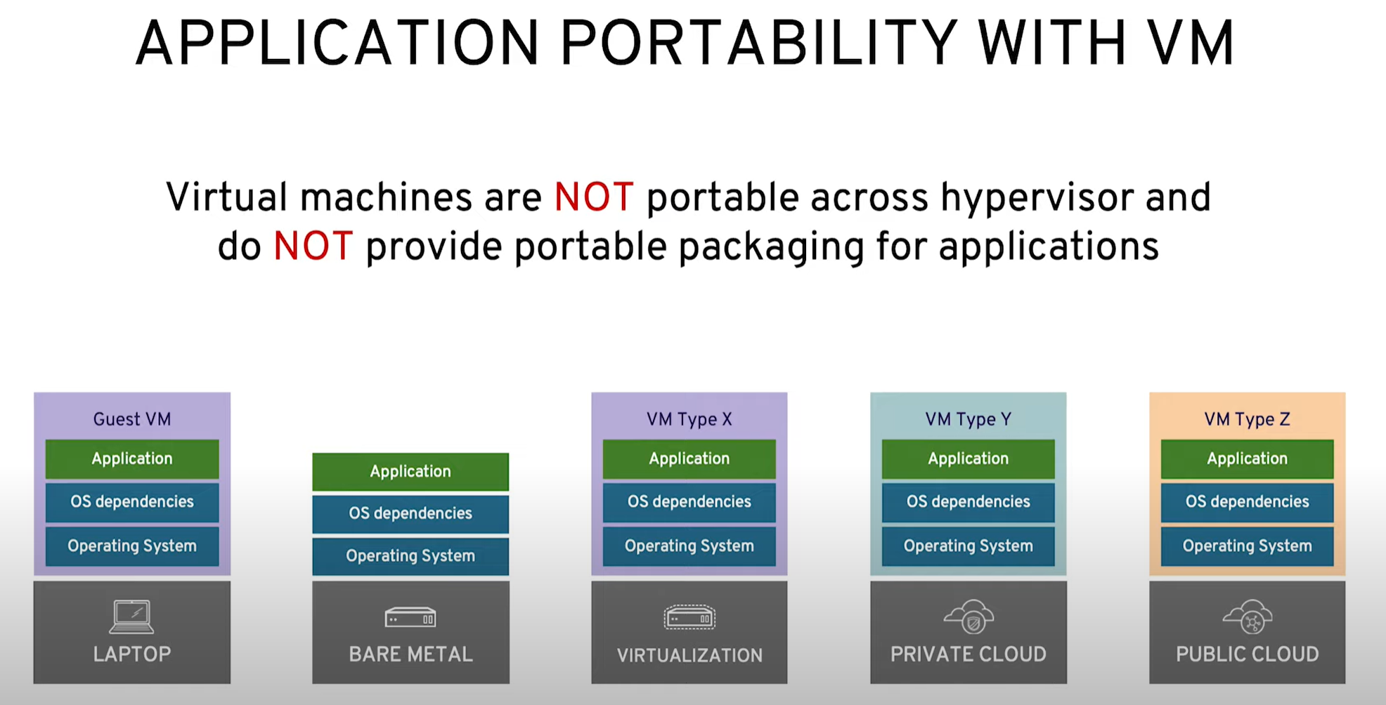
Challenges to Deploy Application to different platform
How to ensure to deploy your application that working fine in your dev environment to production or different platform. Each above platform have different OS, different stack. Therefore portability of your application is a challenge. → Here container solve this problem

Slide 25
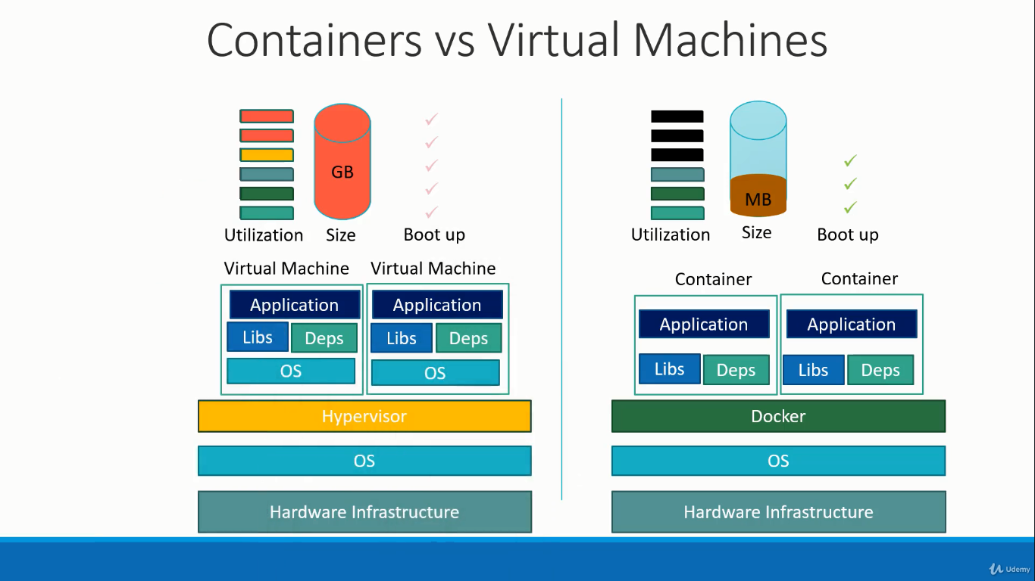
Container
Each virtual machine has its own operating system inside it. Then the dependencies and then the application.
This overhead causes higher utilization of underlying resources as there are multiple virtual operating systems and kernels running. The virtual machines also consume higher disk space as each VM is heavy and is usually in gigabytes in size whereas Docker containers are lightweight and are usually in megabytes in size.
This allows docker containers to boot up faster usually in a matter of seconds whereas virtual machines as we know takes minutes to boot up as it needs to boot up the entire operating system. It is also important to note that docker has less isolation as more resources are shared in containers

Slide 26
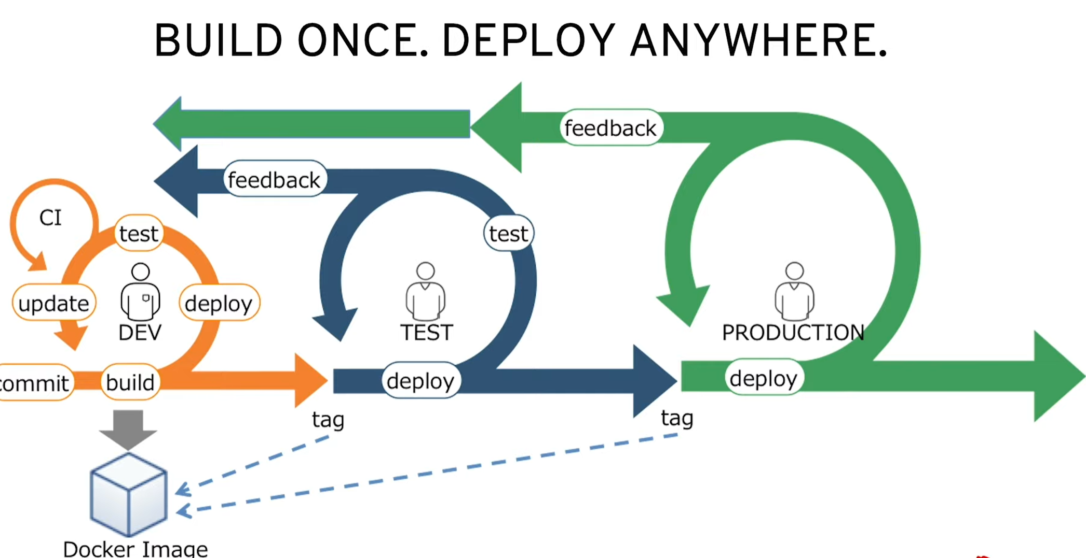

Slide 27
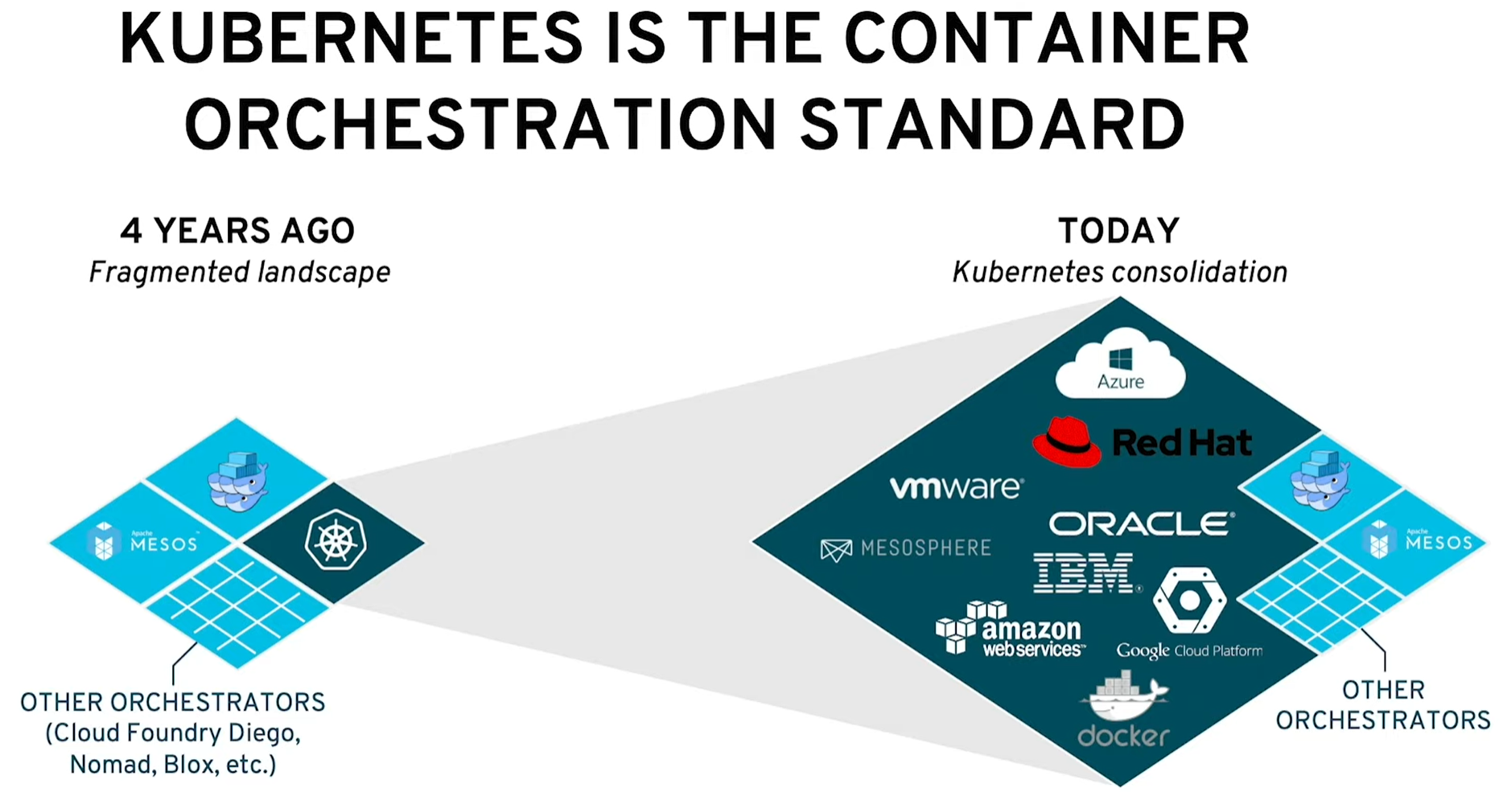
Container Orchestration Solution
We need container orchestration solution to start using container because we need.
Container Host
High availability features, false tolerance features, .
Security capabilities, networking capabilities.
High availability features, access control capabilities, operational requirements.
Logging and matrix
For these all things we need container orchestrator.

Slide 28
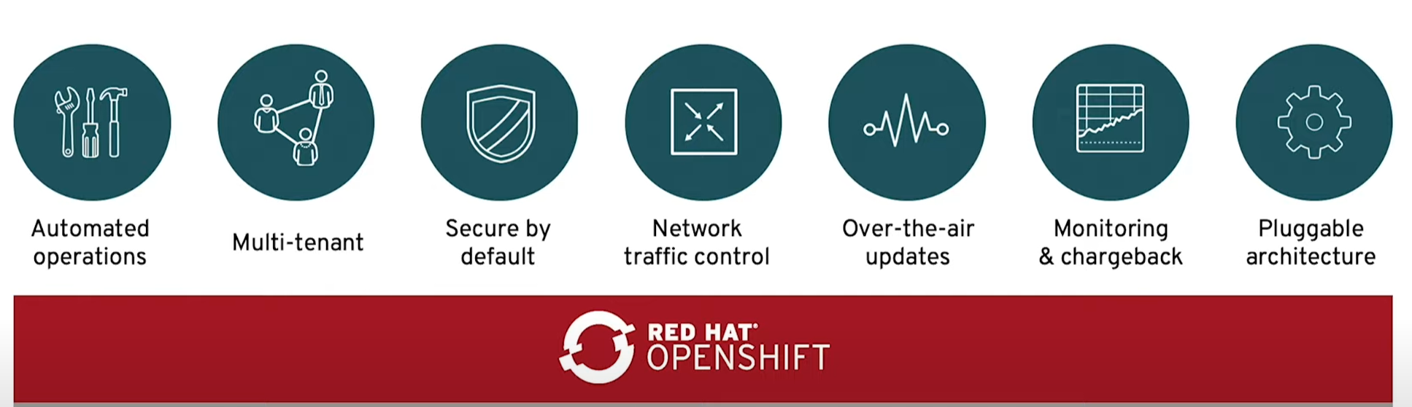
OpenShift
Openshift is powered by Kubernetes and provide above featured and helps operation team to manage all. So Openshift provides enterprise Kubernetes platform.

Slide 29
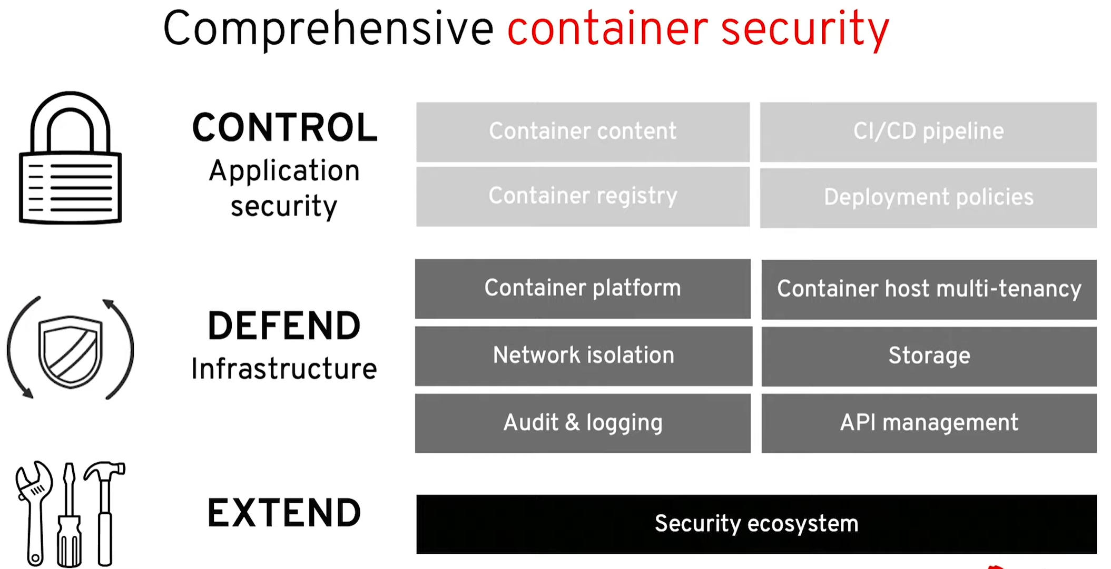
OpenShift

Slide 30
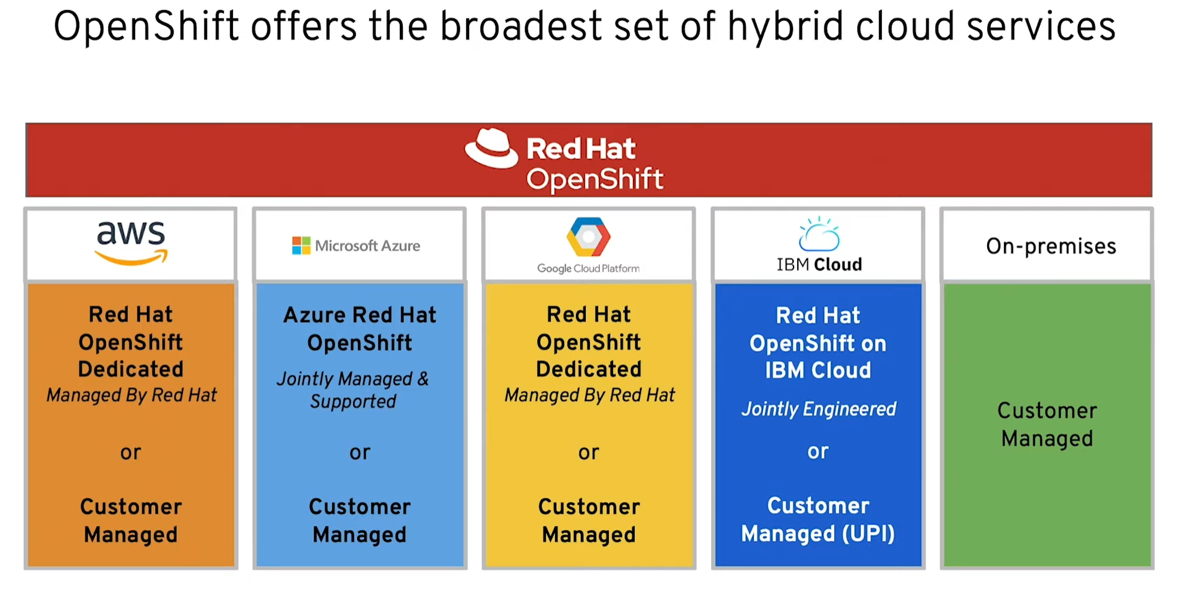
Openshift work with

